Slide 1
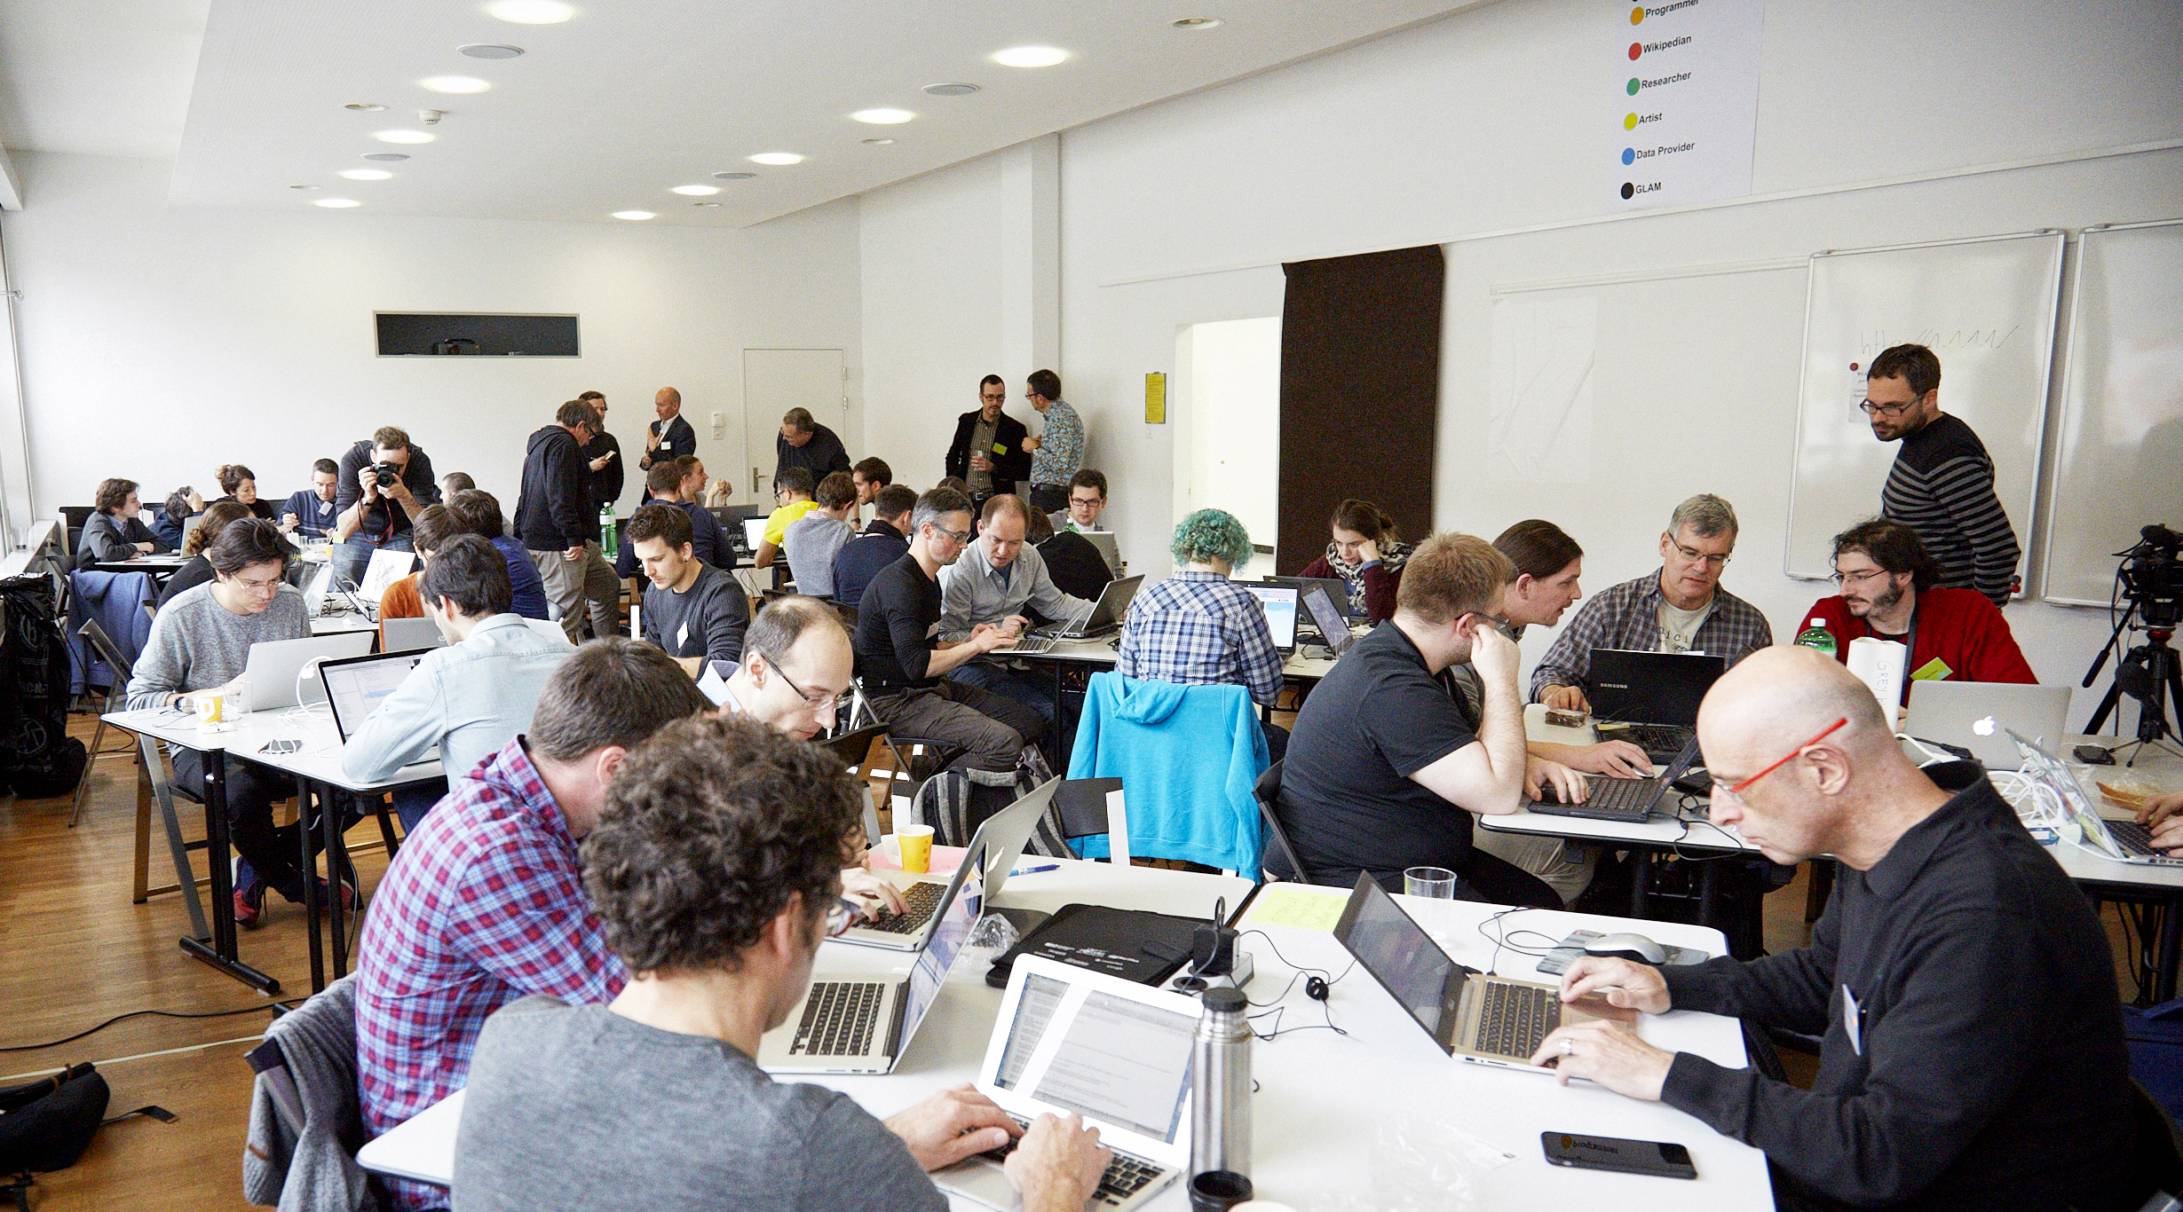
The #dataforbetterhealth initiative
Hackathon “Doc PH”: Practicalities

Slide 2

Start : Friday 25.01.2019 - 16h00 End : Saturday 26.01.2019 - 18h00

Slide 3
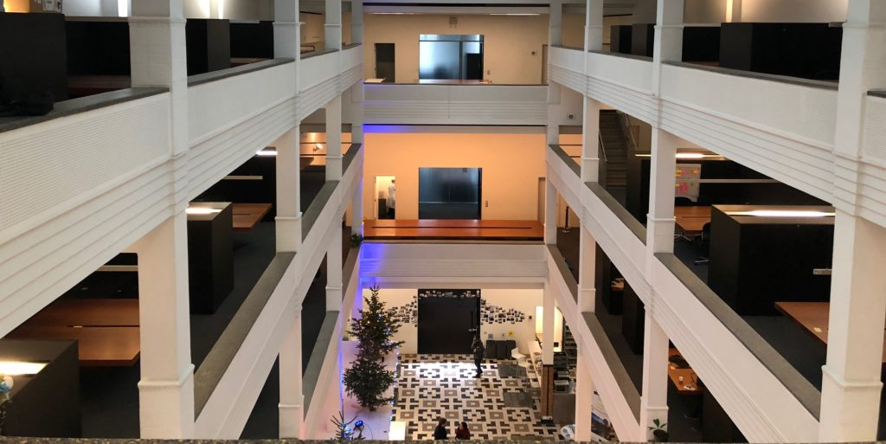
DigitYser: Antwerpselaan 40, 1000 Brussel

Slide 4
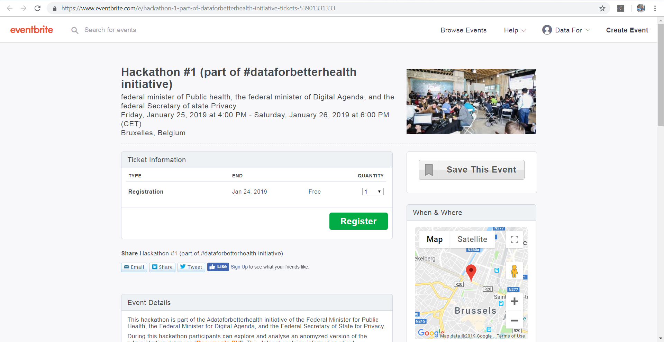
Registration needed

Slide 5
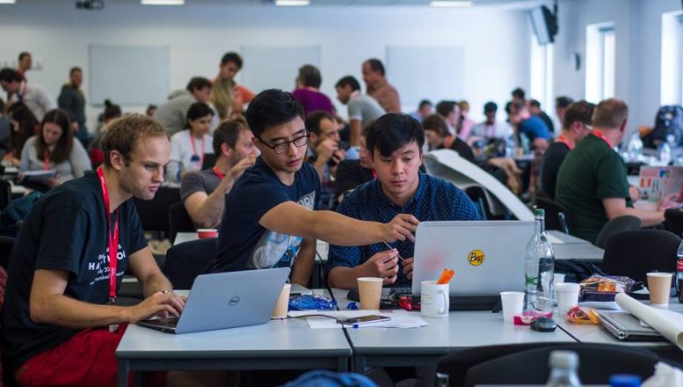
DOC PH = complex data! => need for multidisciplinary teams!

Slide 6

In need for team member with specific expertise? Let us know : info@dataforbetterhealth! We will try to find a match ☺

Slide 7

All resources and references will be on GitHub

Slide 8


RIZIV/INAMI expert will be available for consultation

Slide 9
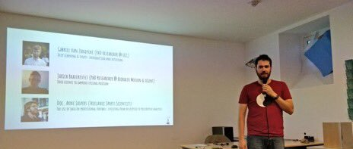
Pitch session, team presentation: Friday 25.01.2019: between 18h00 and 19h00

Slide 10
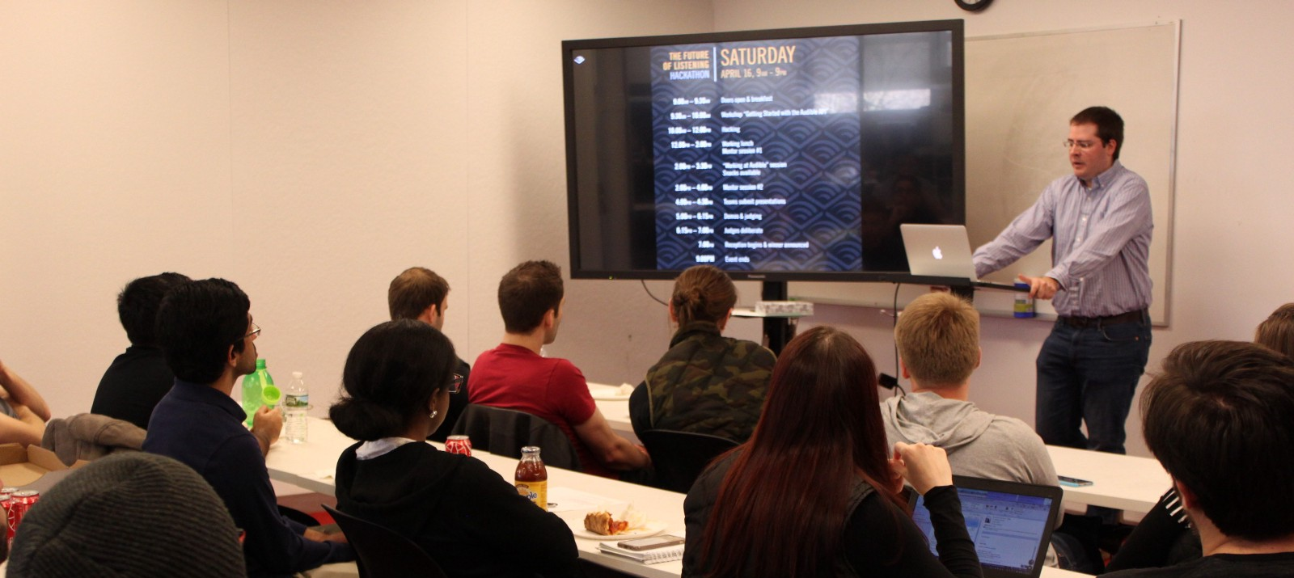
Demo session: Saturday 26.01.2019: between 16h00 and 18h00

Slide 11

Work hard , play hard => Drink Saturday 26.01.2019: 18h00

Slide 12
notepads, pens, flipcharts, post-its, markers, …. will be available

Slide 13


High performance Wi-Fi available

Slide 14

Catering (free) available

Slide 15
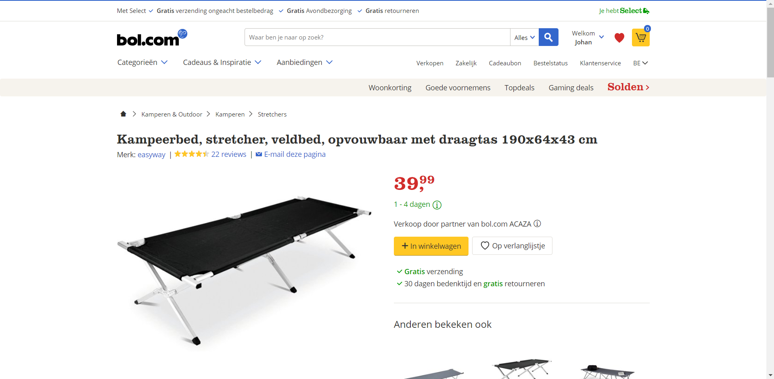
Don’t want to go home? No problem, bring your camp bed ☺

Slide 16

Q & A

Slide 17


follow us!
#dataforbetterhealth
an INITIATIVE of the federal minister of Public health, the federal minister of Digital Agenda, and the federal Secretary of state of Privacy

